Slide 1


Establishing the determinants and potential solutions for pharmacy professionals engaging with research; a theory-based national survey
Charlotte Jones on behalf of the NIHR-Supported Incubator for Pharmacy Professionals

Slide 2
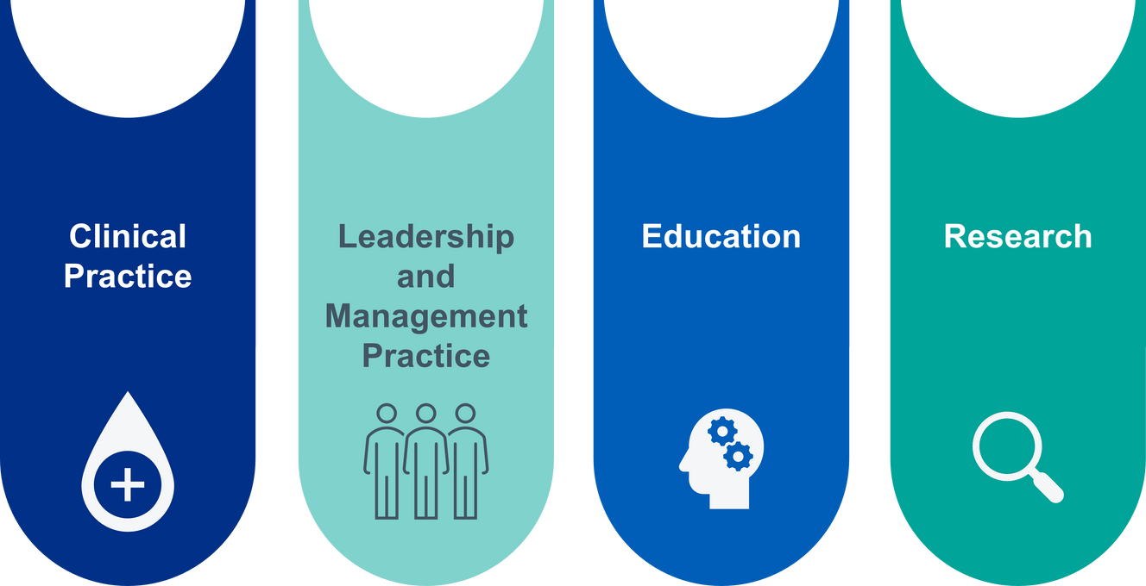
Why research?
“Making research everybody’s business”
Pharmacy professionals accounted for only 2.7% of the applications in the NIHR doctoral fellowship pool during 2014–2021

Slide 3

Survey
Aims
Sought to establish the agreement to identified determinants (barriers enablers) in focus groups with the rest of the profession
Results used to inform co-design workshops to address established determinants and potential solutions to increase research capacity
Survey was informed by previous focus groups and underpinned by the Theoretical Domains Framework

Slide 4
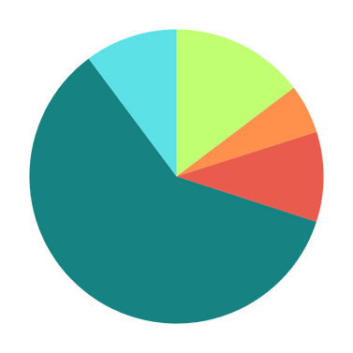
Jan – Feb 2025 -> 871 responses.
The majority of respondents were pharmacists (79.1%), and the remainder pharmacy technicians (20.9%).
Most respondents were from secondary care (64.1%) followed by primary care (15.6%).
The majority were based in England (82.5%).
Results
No research experience (14.7%)
Other (5.4%)
Experience in grants/research projects (9.9%)
Experience in audit/service evaluation (59.8%)
Experience in research delivery (10.2%)

Slide 5
Capability-related domains
Mentorship to help monitor progress in research
Opportunity-related domains
Available time to do research
Results
Research embedded into pharmacy job plans and career pathways
Receiving encouragement would support research engagement
Hearing about research to inspire research engagement
Motivation-related domains
Would engage with research if it were required in revalidation
Small-scale projects build confidence to engage with research
Patient/policy outcomes as motivations to do research
A personal benefit to incentivise research engagement

Slide 6

Thank you!
Interested in our work or want to be involved? Get in touch!
LinkedIn: Pharmacy Research Professionals

